Slide 1
A TRANSFORMATIVE INVESTMENT IN CALIFORNIA’S FUTURE
Michelle Boehm
Southern California Regional Director
April, 2015

Slide 2
HIGH-SPEED RAIL: More Than A Transportation Program
California is 8th Largest Economy in the World
Comparable to Northeast Corridor in Terms of Distance, Population and Complexity
Transformative Investment
Connecting all California Population Centers

Slide 3
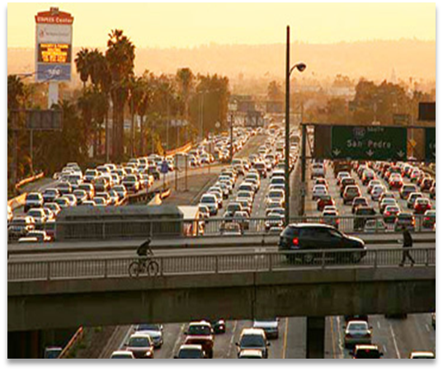
Why high-speed rail in California?
Curbs Congestion
LAX to SFO is the Busiest Short-Haul Market in US
1 in 6 Flights out of LA Heads to Bay Area
Six of Top 30 Congested Urban Areas in US Located in
California
Population Growth
Estimated to Reach 50 Million by 2050
Air Quality/Sustainability
Meets Goals of AB 32/SB 375
Worst Air Communities in the Country
Alternatives are Costly
2-3 Times More Expensive

Slide 4
High-Speed, A More EFFICIENT ALTERNATIVE
High-Speed Rail Fills a Gap in California’s Infrastructure
Equivalent New Capacity Between SF-LA would cost $158 billion, and would require:
4,300 New Highway Lane Miles
115 Additional Airport Gates
4 New Runway Terminals

Slide 5
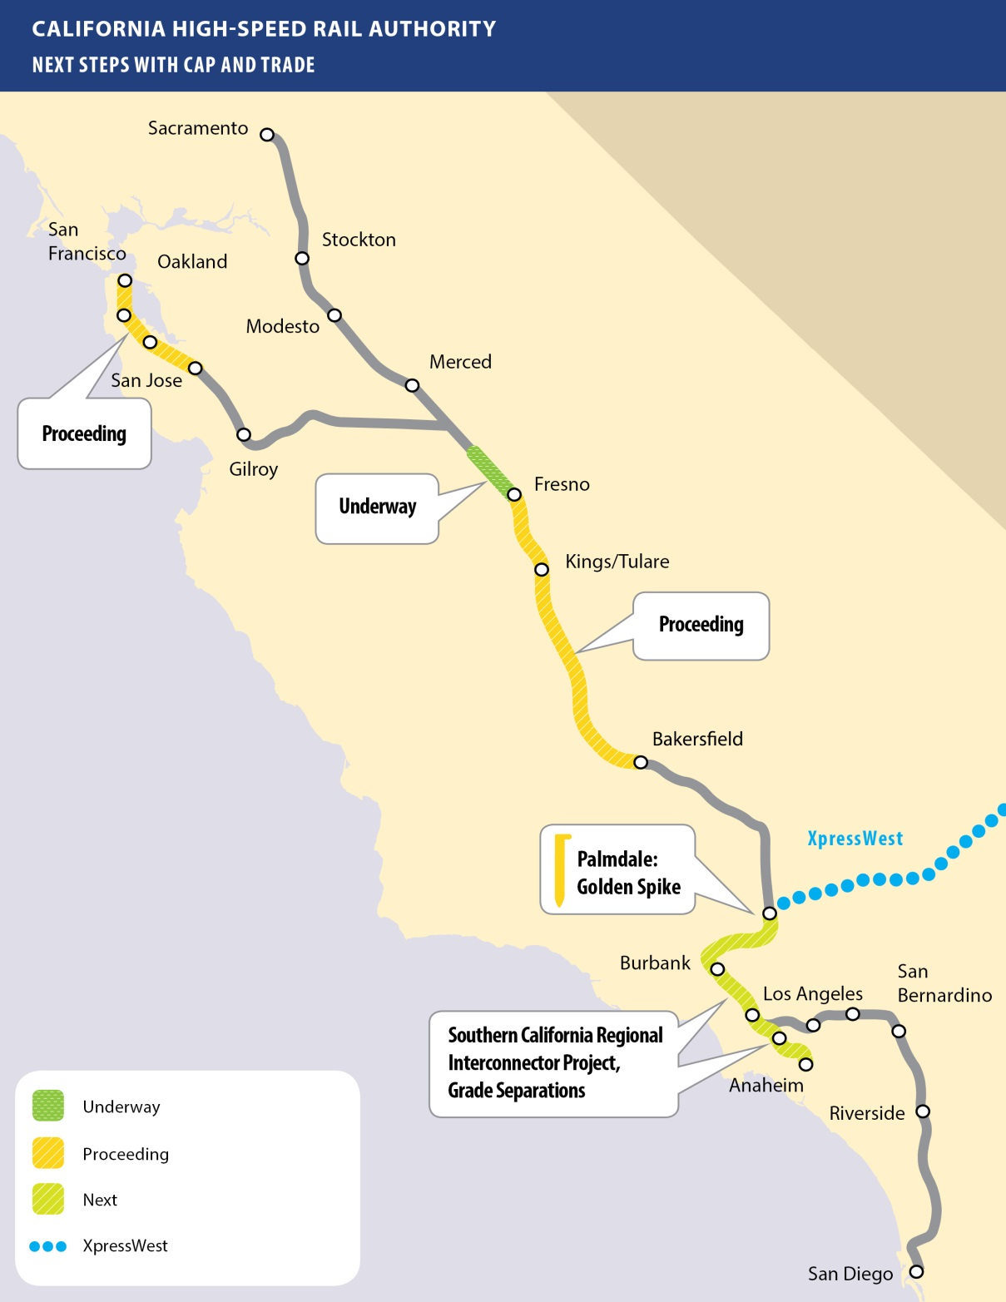
Next Steps with CAP & trade
Advance Multiple Segments of High-Speed Rail Concurrently
Complete Planned Regional Transportation Improvements
Establish an Interstate High-Speed Rail System with a Connection to Las Vegas from Palmdale

Slide 6
Northern California: electrification & connectivity
Electrification of the Caltrain Corridor
Environmental Review Complete
Request for Proposal on the Street
Transbay Terminal
Construction Proceeding
Station Area Planning
Gilroy & San Jose

Slide 7
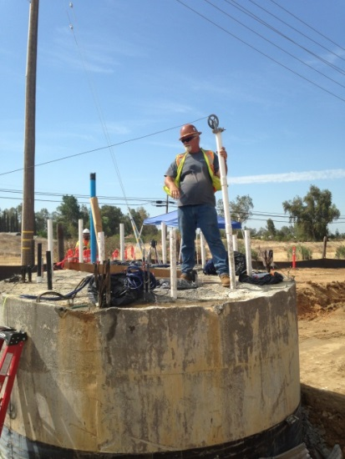
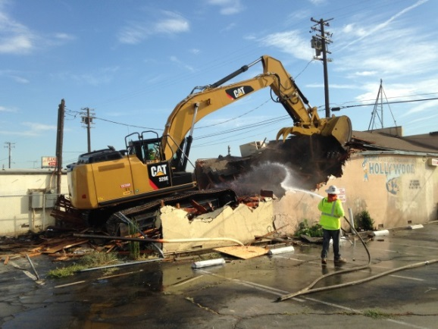
Central Valley: Backbone of high-speed rail
Construction Package 1
29 Miles Between Madera and Fresno
Work is Underway
Construction Package 2-3
65 Miles Between Fresno and Tulare-Kern County Line
Environmental Clearances Complete
Design-Build Contract Execution Expected in Spring
Construction Package 4
22 Miles Between Tulare-Kern County Line and North of Bakersfield
Environmental Clearances Complete
5 Statements of Qualifications Received

Slide 8
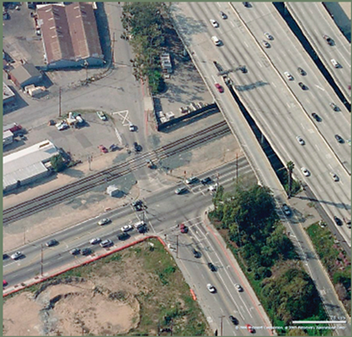
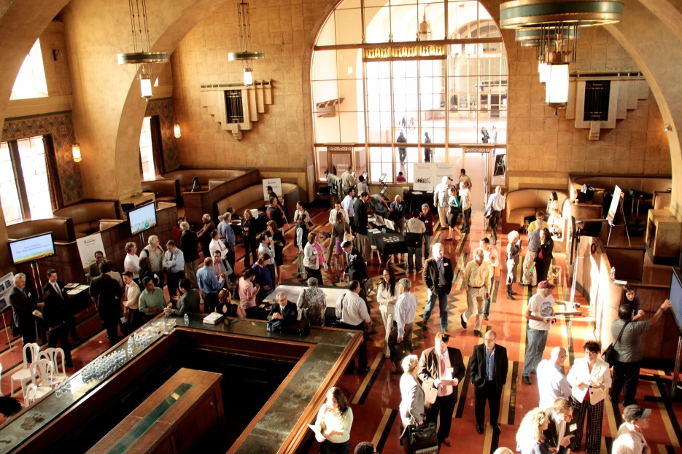
Southern California: acceleration & Connectivity
Palmdale to Burbank/Burbank to Los Angeles
Public & Community Feedback
Palmdale: Golden Spike
Connectivity & Bookend Projects
Southern California Regional Interconnector Project (SCRIP)
Grade Separations
Station Area Planning
Palmdale, Burbank & LA Union Station

Slide 9
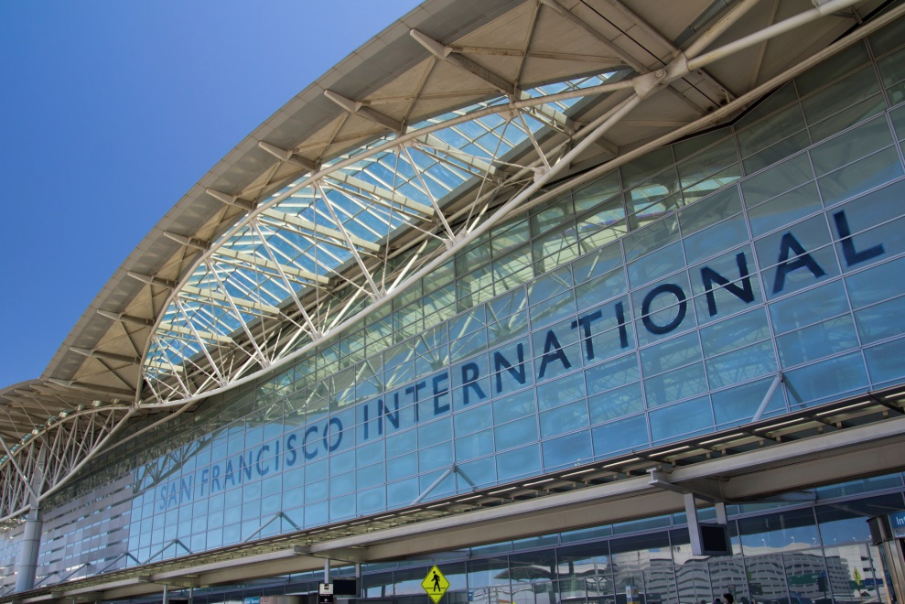
Southern California: connecting major hubs
Approximate Travel Times Between Cities
Palmdale to Burbank in 11 - 15 minutes
Burbank to LA Union Station in 6 - 8 minutes
LA Union Station to Anaheim in 30 minutes
LA Union Station to San Diego in 1 hour, 20 minutes
Relieves Airport Congestion
Connects Airports: SFO, Bob Hope Airport, Ontario Airport and San Diego Airport
Connects Transportation Hubs: San Jose, LAUS, ARTIC

Slide 10
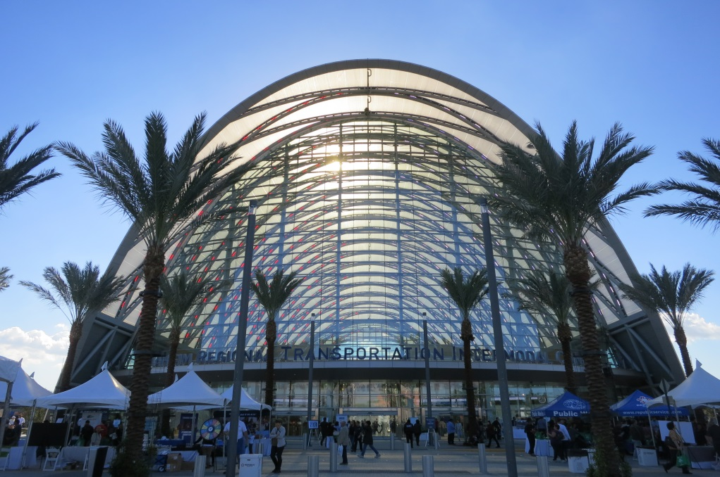
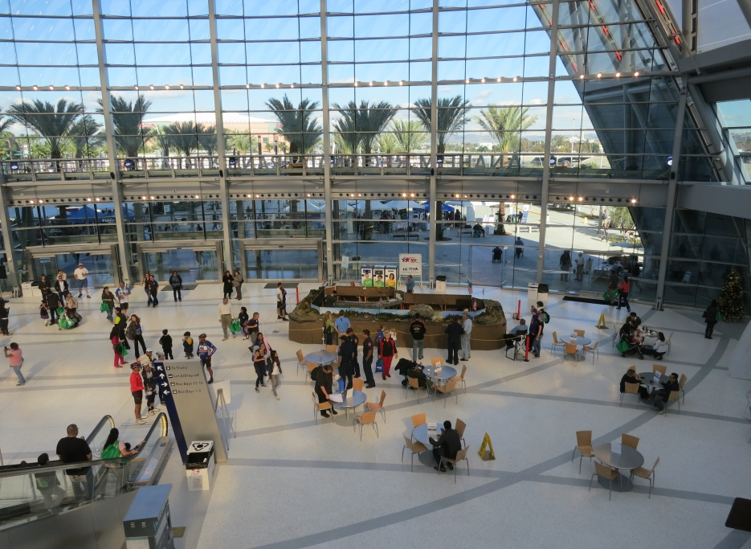
Southern California: Connecting tourism & economy
Visitors to Los Angeles in 2014: 43.4 million people
Visitor spending in Los Angeles (2013): $18.4 billion
SoCal Stations
Palmdale
Burbank/San Fernando Valley
LAUS
ARTIC
Fast Track to Destinations (South To North)
Disneyland Resort, Anaheim Stadium, US Midway Museum, San Diego Qualcomm Stadium
Music Center, MOCA, Grand Park, Broad Museum, Universal City, Angeles National Forest
Antelope Valley, Las Vegas
High Sierras, Yosemite, Silicon Valley, San Francisco
Smart, Transit-Oriented Station Area Development

Slide 11
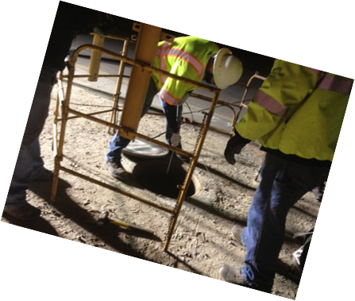
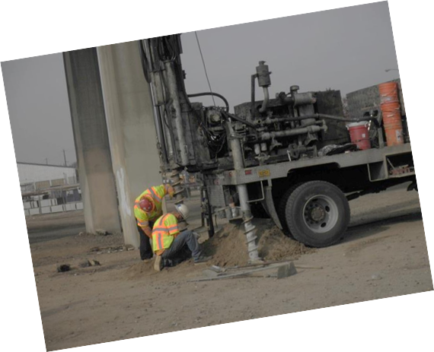
Connecting California: jobs
Targeting: California
Construction: Direct, Indirect Jobs
in Hard-Hit Sectors
Permanent: Rail Modernization
Creates Efficiencies Statewide

Slide 12
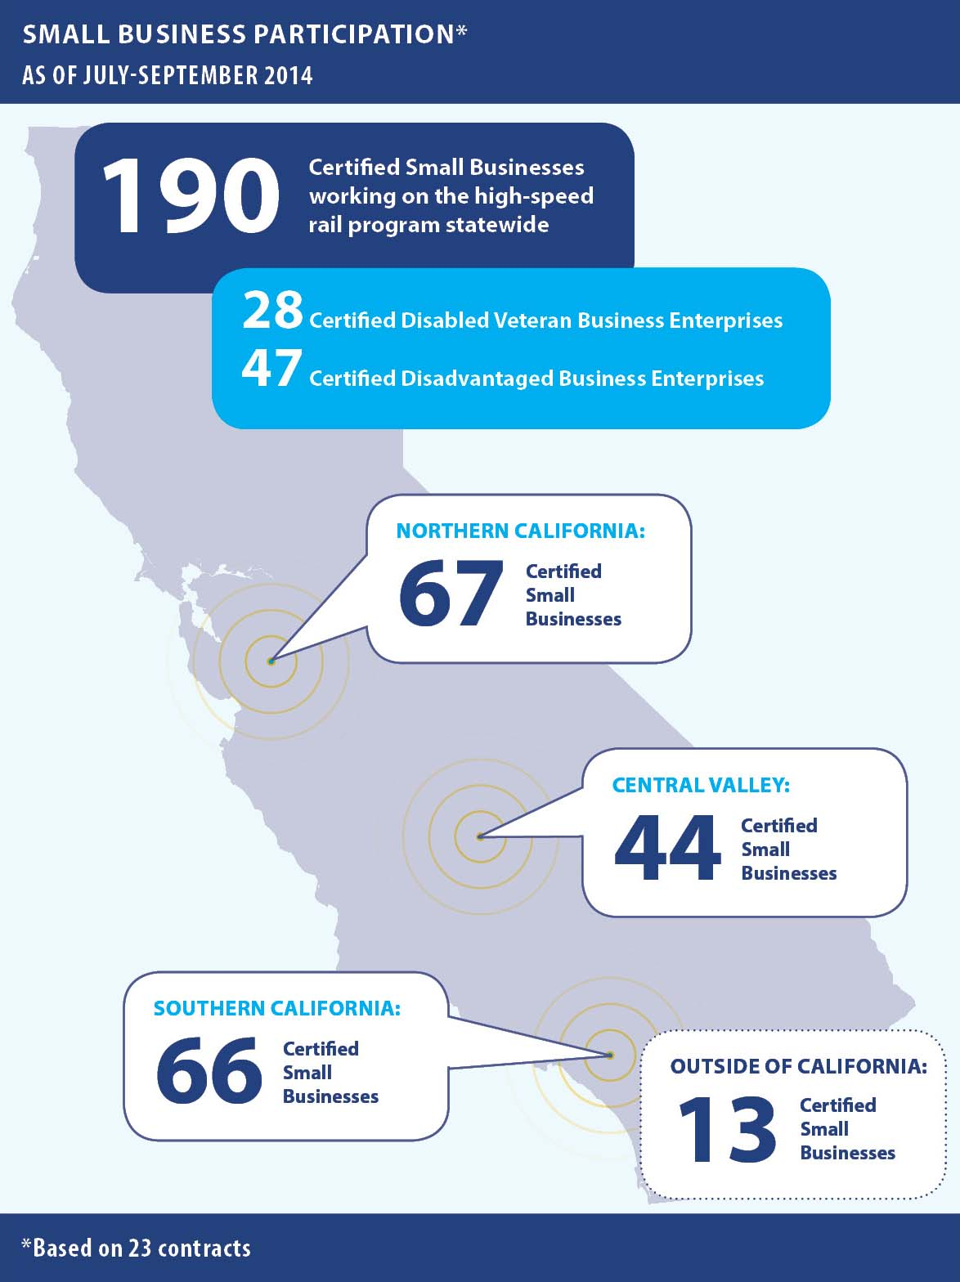
SMALL BUSINESS PROGRAM
30% Goal for Small Business Participation
10% Disadvantaged Business Enterprises (DBE)
3% Disabled Veteran Business Enterprises (DVBE)

Slide 13
Sustainability Program
Policy
Sustainable Design
Net-Zero Emissions
Renewable Energy
Comprehensive Mitigation
Implementation:
Planning at Scale/MOUs
Design/Construction Contract Conditions
Mitigation Measures/Permit Conditions
Energy
Communities and Ridership
Sustainable Infrastructure
Business and Management
Natural Resources

Slide 14
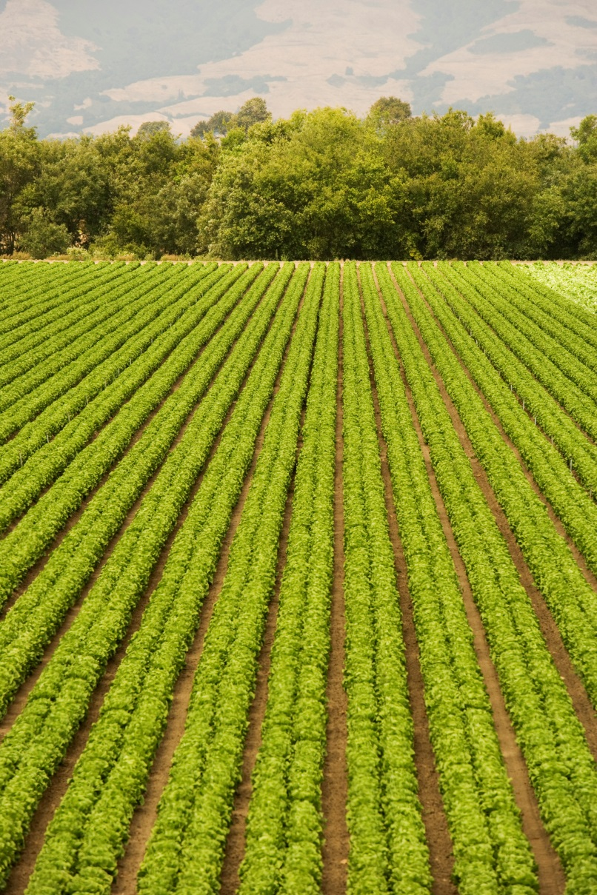
Environmental Benefits: Our Best kept secret
Preserving Agricultural Land
Reducing Criteria Pollutants and Greenhouse Gases
Urban Greening: Tree Planting
Tier VI Construction Equipment
Recycling During Construction
100% Renewable Energy
Preserving and Enhancing Critical Habitat and Wetlands
Early Development of Storm Water Management Standards

Slide 15
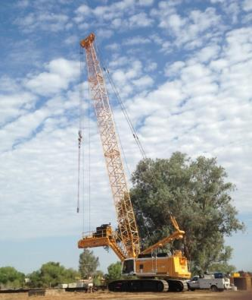
GHG reduction
Clean, Green Trucks for the Site (Tier IV)
» Efficient Filters and Engines that Reduce Criteria Pollutants
» Capacity to Handle Biofuel Mixes
» Brought by Contractor, Setting Precedent
for Other Construction in the State
Other On-Site Actions
» Anti-Idling
» Dust Suppression with Non-Potable Water
» Streamlining and Consolidation of
Materials Deliveries
Tree Planting Program
» 5,000 Initial Trees in CP 1
» Targeting Disadvantaged Communities

Slide 16
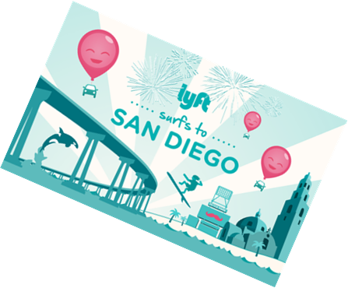
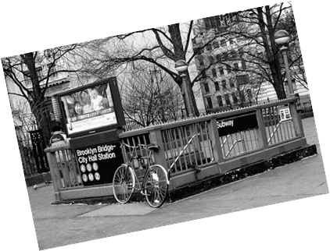
Millennial generation: A shift in perspective
Average Americans:
6% Decrease in Miles Driven in 2011 vs. 2004
Drivers 16-34 Years:
23% Less Miles Driven from 2001 to 2009
Ownership Alternatives:
Bike, Zip Car, Lyft, Uber, Mega Bus
Embrace Public Transport
Los Angeles Metro and Metrolink
BART and Muni (Bay Area)
Amtrak

Slide 17
Thank you
Michelle Boehm, Southern California Regional Director
(213) 308-4507 michelle.boehm@hsr.ca.gov
Headquarters California High-Speed Rail Authority 770 L Street, Suite 800 Sacramento, CA 95814 www.hsr.ca.gov
facebook.com/CaliforniaHighSpeedRail
twitter.com/cahsra
youtube.com/user/CAHighSpeedRail

